Slide 1
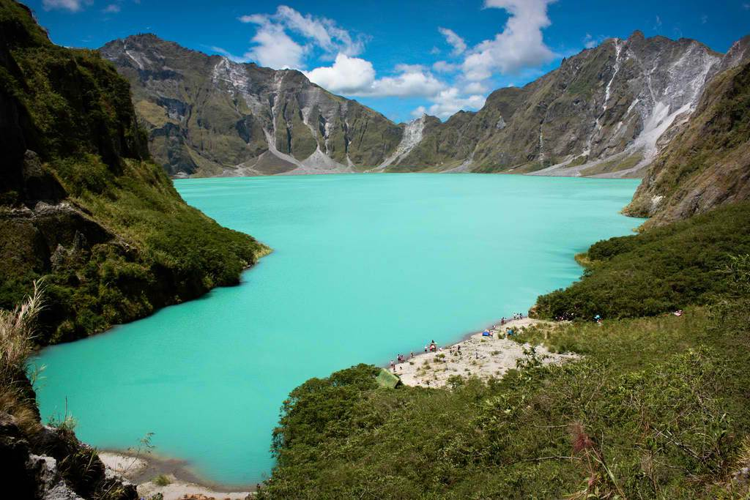
Mount Pinatubo
By Adele O’ Reilly & Ben McCauley

Slide 2
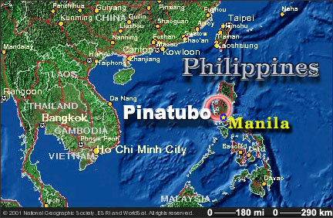
Location & Volcano type
Mount Pinatubo is a volcano located on the island of Luzon in the Philippines. Nestled in the central part of the Zambales mountain range, the volcano lies 55 miles northwest of the capital city of Manila.Before the eruption, Mount Pinatubo was covered with tropical vegetation and was home to more than 30,000 people who lived in villages on its slopes.
Pinatubo is a stratovolcano on the island of Luzon.A stratovolcano is a conical-shaped volcano composed of steeply-dipping layers of lava, hardened ash, and other material erupted from the main volcanic vent. Stratovolcanoes are also commonly called composite volcanoes.

Slide 3
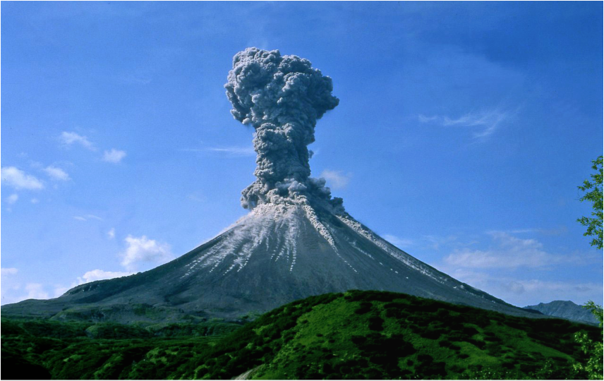
Eruption
On June 1991, the second largest volcanic eruption in the 20th century took place on the island of Luzon in the Philippines(90 km northwest of the capital city of Manila.The eruption lasted for nine hours and caused numerous large earthquakes due to the collapse of the summit of Mount Pinatubo and the creation of a caldera. Following the eruption, up more than 800 people were killed and 100.000 became homeless. On June 15, tons of sulfur dioxide were discharged into the air causing the temperature to drop worldwide over the next few years.

Slide 4
Past Activity
Mount Pinatubo has had several past eruptions: 1900 - 300 BC (Maraunot Eruptive Period) AD 1500 (Buag Eruptive Period). 1991 eruption The 1991 eruption was a smaller eruption and the other two had several eruptions not just one. Each of these eruptions seems to have been very large, ejecting more than 10 km³ of material and covering large parts of the surrounding areas with pyroclastic flow deposits. Some eruptive periods have lasted decades and perhaps as much as several centuries and might appear to include multiple large Pinatubo, Inararo, was also its largest. The Mt Pinatubo eruption of 1991 was the second largest eruption of the 20th century. Mount Pinatubo Volcano had been dormant for 400 years. Before 1991 Pinatubo was an inconspicuous volcano which was known to be active in the past 1000 years and was the site of a failed geothermal development. This means that it could be in a period of activity now meaning that future eruptions could be possible.

Slide 5
Past and future Hazards
The climactic eruption destroyed the volcano's original summit. In its place left a 2-km-diameter caldera. The caldera formed from collapse of the volcano's summit on June 15 during the period of large earthquakes in response to withdrawal of a large volume of magma from the reservoir beneath the volcano
.Volcanic hazards continue to exist at Mt. Pinatubo more than a decade of the 1991 eruption. Most of these hazards are involving the re-deposition of pyroclastic flow and fall deposits such as lahar. Many of these processes go unobserved as they occur in river valleys that have been inaccessible for several years following the eruption.
coincidence of the climactic eruption on June 15, 1991, with a typhoon led to more than 300 deaths and extensive property damage, both caused primarily by the extraordinarily broad distribution of heavy, water-saturated tephra-fall deposits. Runoff from The typhoon rains is eroding and redistributing the pyroclastic deposits emplaced during the eruption. The resulting lahars, floods, and sedimentation have caused severe social disruption and will be an enormous recurring problem in future years

Slide 6
Rock formation of Mt. Pinatubo
Rocks formed in the eruption of Mount Pinatubo: Rocks found at Mount Pinatubo today are mostly dacite and andesite. Andesite is a volcanic rock that is gray to black in color. This rock mostly comes from stratovolcanoes in a form of thick lava flows. Basalt lava is a volcanic rock that's hard and black in color. It flows fast which allows volcanic gases to escape without explosions. It is the most common rock type in the Earth's crust and ocean floor Pumice is light type of rock also found at Mount Pinatubo. It forms during eruptions. Pumice is full of holes caused by expanding volcanic gases. It is made up of volcanic glass and minerals, and can form in all types of magma. Obsidian is another rock found at Mount Pinatubo. It is usually black in color though it can also be red. It is a dense volcanic rock, usually composed of rhyolite, rich in iron and magnesium.Obsidian is formed when the lava cools so quickly that crystals do not have time to grow

Slide 7
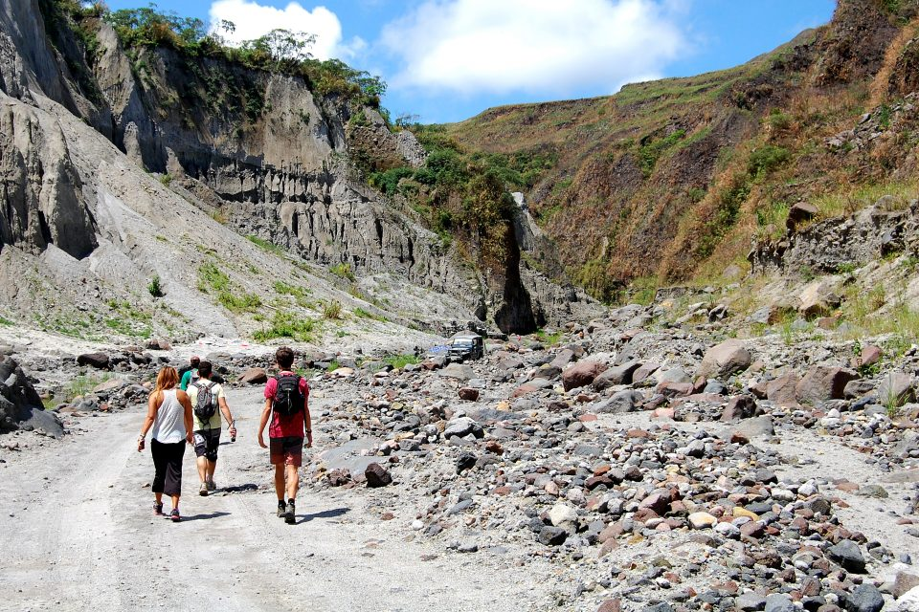
Mt. Pinatubo today
The volcano today is a safe place to visit. The crater of the volcano is a beautiful lake that is 2.7 kilometers wide and the water is crystal clear. However it is advised not to swim in the water of the lake.
Although the volcano is still active, it is very closely monitored and any activity will most likely be predicted, thus trekking there is a safe activity, especially when it is done in the presence of local guides who know the area.

